Slide 1
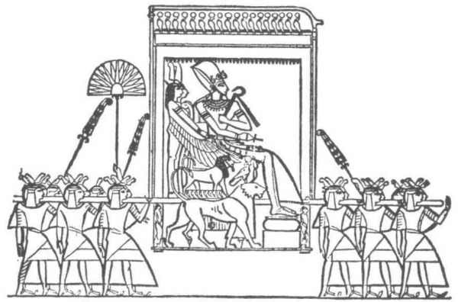
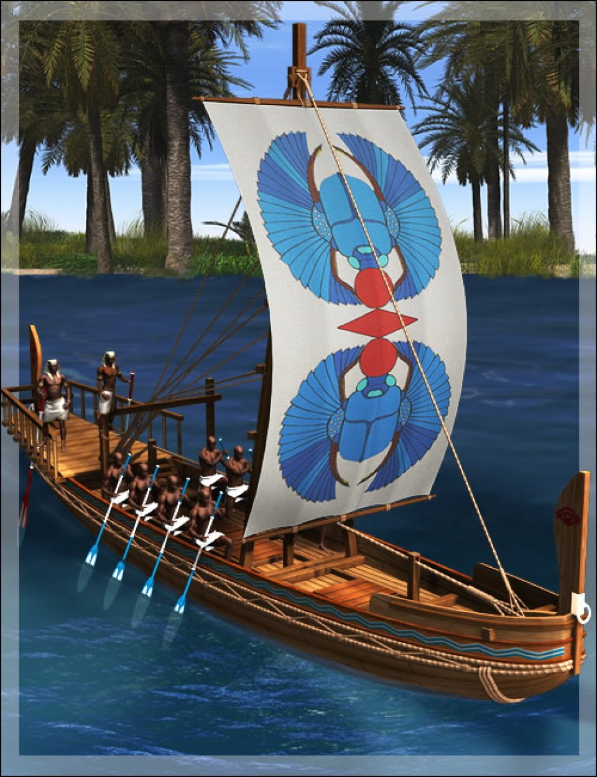
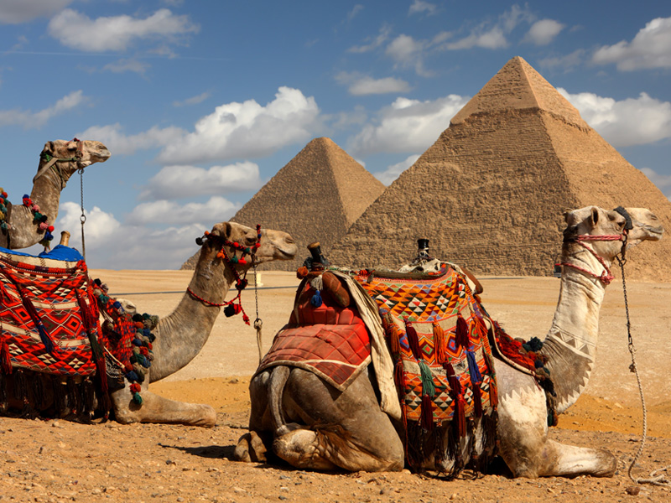
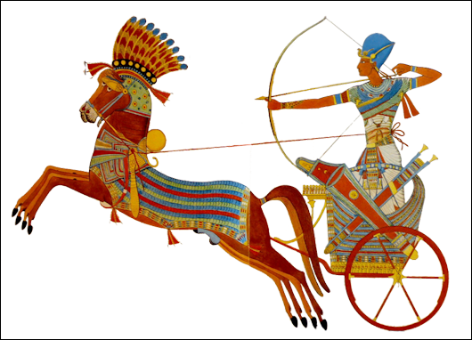
Ancient Egyptian Transportation
by Haylei Torres
Jacqueline Madrid
Christina Halloran
Period 1
January 2016

Slide 2
Understanding Transportation in Ancient Egypt
Transportation, or Movement, is one of the 5 Themes of Geography. It answers the question, “How do people, goods, and ideas move from place to place?”
This can help us understand how the Ancient Egyptians were connected with other regions, cultures, and people in their world.
This can help us understand how we are connected with the Ancient Egyptians in our world.

Slide 3
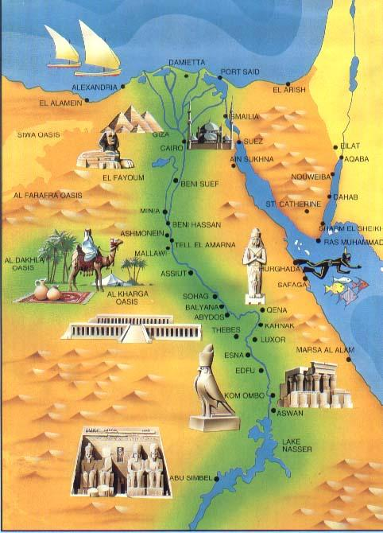
5 Means of Transportation in Ancient Egypt
Walking
Animals
Litters
Chariots
Ships

Slide 4
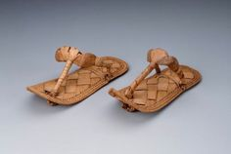
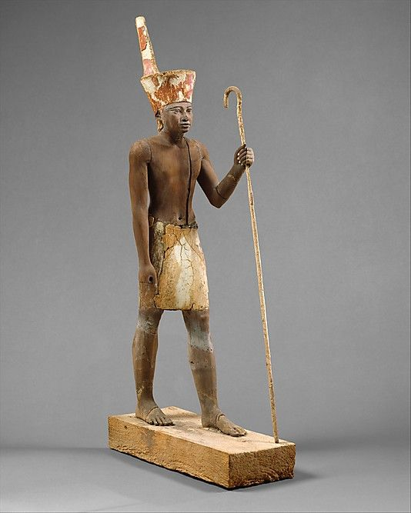
Walking
“Do not walk the road without a stick in your hand” - Anksheshinq
Most Egyptians went about by foot
They used sandals made of papyrus
Many travelers used walking-sticks
The walking-stick served both as a weapon against robbers as much as a walking aid

Slide 5
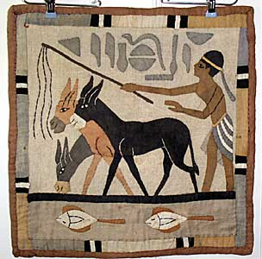
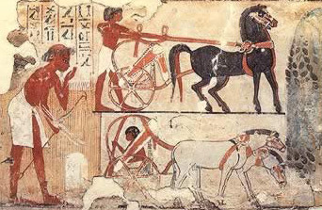
Animals
Donkeys were the most commonly used animal to carry loads. They were sometimes used for riding too.
It is believed there were millions of donkeys in Ancient Egypt.
Mules, horses and oxen also may have been used to pull carts or carry loads
Camels were probably not used until a much later period in the Egyptian civilization

Slide 6
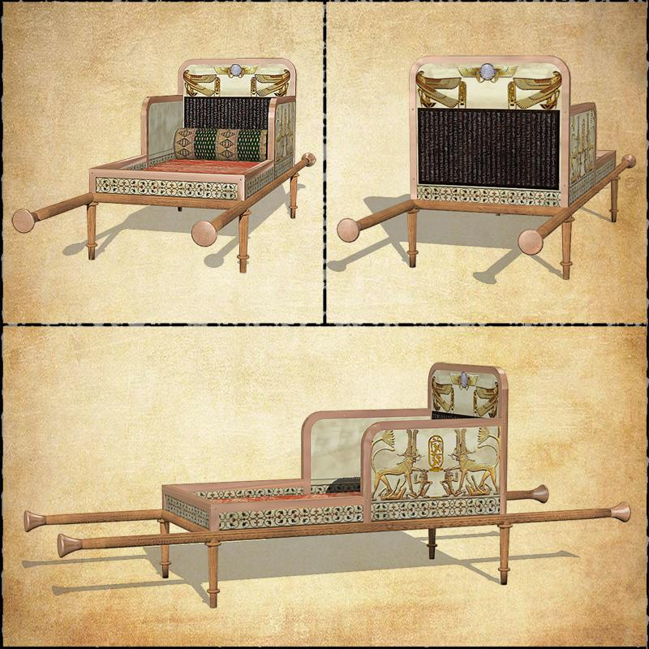
Litters
Litters were “chairs” carried by men or animals
They were made of a light frame of wood, and sometimes had a covering over the top
Only the upper classes used litters
Litters were often used for ceremonial purposes

Slide 7
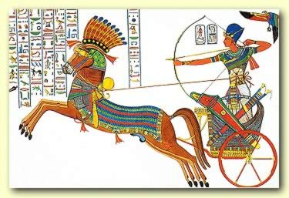
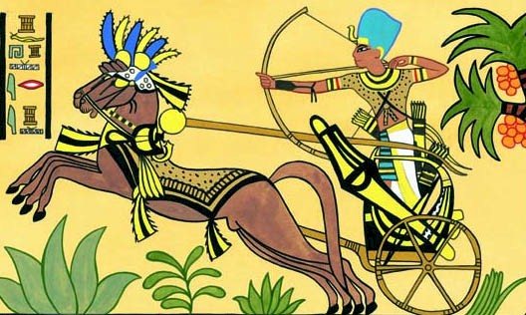
Chariots
Chariots are light, two-wheeled, horse drawn vehicles
Horses were usually not ridden but are instead harnessed to chariots
Chariots were very fast so Pharaohs liked to use them
Chariots were very expensive to keep so they were only used by the upper classes and the military

Slide 8
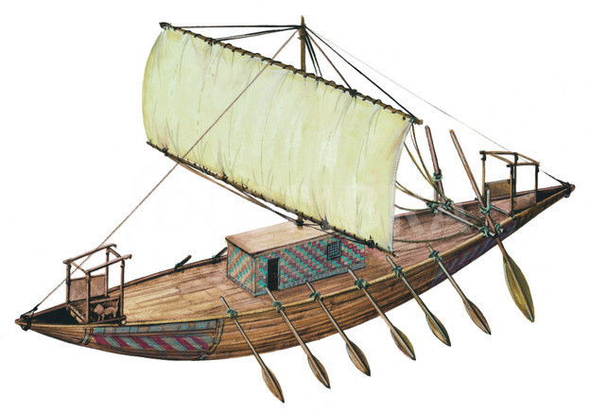
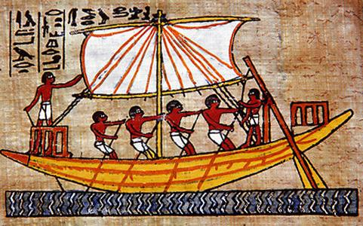
Ships
Because of the Nile River, ships were a vital means of transportation in Ancient Egypt
Cedar wood was important from Phoenicia to build the ships because it was stronger than the local wood
Ships mainly used sails and oars, but sometimes they were pulled up river by animals
Instead of bridges, smaller ships called ferry boats, were used to cross the Nile in narrow places from east and west

Slide 9
Summary
The majority of people got around just by walking
Donkeys were used the most to carry loads
Rich people might have themselves carried in a litter, especially for ceremonial reasons
Chariots were a fast, but expensive, way to get around, so they were used mainly by the military
Egypt’s location along the Nile made all types of ships essential for transportation

Slide 10
Bibliography
Jacobs, Heidi Hayes. The Ancient World. Upper Saddle River, New Jersey:
Prentice Hall, 2003.
Kaplan, Leslie C. Land and Resources of Ancient Egypt. New York: Rosen
Publishing Group, 2004.
“Pharaonic Egypt: Means of transportation.” January 1, 2011
http://www.reshafim.org.il/ad/egypt/timelines/topic/meansoftransportation.
Sands, Stells. “Kids Discover: Ancient Egypt.” Kids Discover 2003: 2-5.

